Slide 1
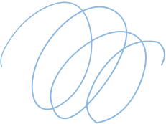
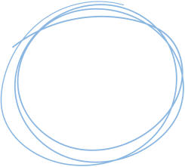
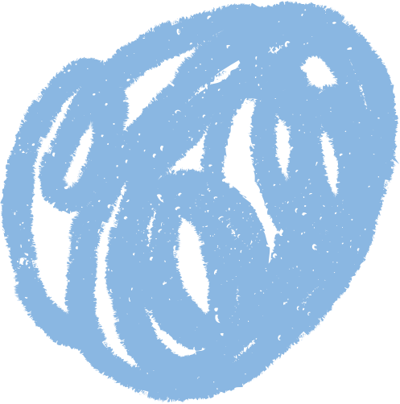
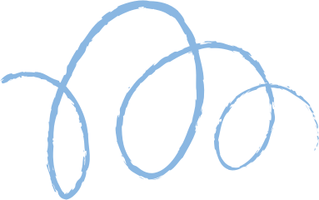









Neural Style Transfer
(Blending Art & Vision with Deep Learning)
Name - Lavkesh Madavi
Roll No - 2311MC08

Slide 2
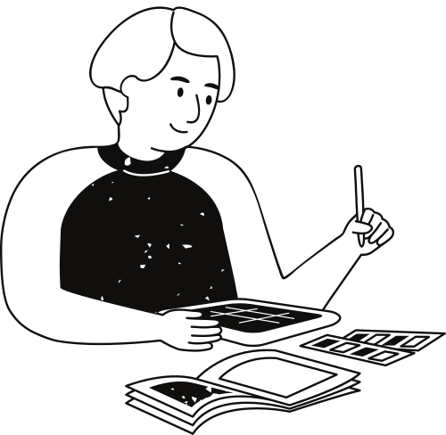
Project Overview
Objective:
To create artistic images by combining the content of one image with the style of another using deep learning techniques.
Key Features:
Classical Neural Style Transfer (VGG19)
Fast Neural Style Transfer (TF Hub pre-trained model)
Gradio-based live demo UI
GPU support for faster processing
Tools & Libraries:
TensorFlow, TensorFlow Hub
NumPy, Matplotlib, Pillow
Gradio (for UI)

Slide 3
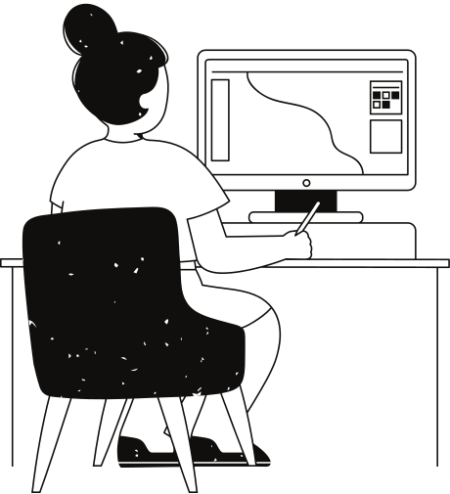
Methodology
1. Classical NST:
Uses VGG19 to extract content & style features
Optimizes total loss (Content + Style + Total Variation)
Slow but fine-tunable & educational
2. Fast NST:
Pre-trained TF Hub model: arbitrary-image-stylization-v1-256
Real-time output generation
Great for deployment & UI apps
Architecture Overview:
Input → Feature Extraction → Loss Calculation → Optimization (Classic)
Input → Direct Stylization via Feedforward Model (Fast)

Slide 4
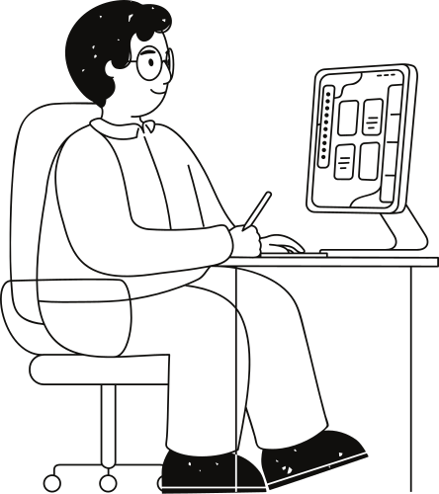
UI & Demo
Demo App:
🔗 Live Hugging Face Space
UI Preview:
Upload content + style image
Toggle GPU usage
Instant stylized output preview

Slide 5
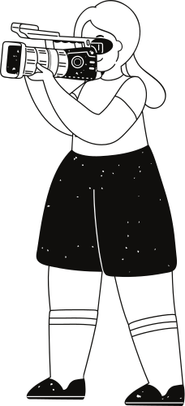
Conclusion
Classical NST:
⏳ Slow
✅ Fine-tuning
🎯 High Output Control
Fast NST:
⚡ Real-time
❌ Limited Customization
🚀 Low Output Control
Conclusion:
Neural Style Transfer merges deep learning with creativity.
Fast NST is ideal for UI and real-world deployment.
Classical NST offers in-depth control for experimentation.

